Slide 1

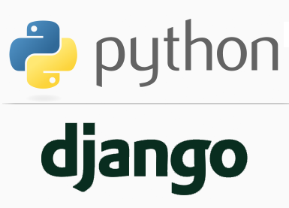
FULL STACK WEB DEVELOPMENT WITH DJANGO
Lecture10

Slide 2

Today’s Agenda
Developing Our Django App
The Multiple Folder Approach
Configuring Templates
Example

Slide 3
Creating Separate Template Folder
As a Django project grows in size it’s often more convenient to arrange all the templates , app wise , rather than putting them inside one main template folder
For this we first create a templates directory inside the default project folder as we did before
Within the templates directory we create a subdirectory by the name of app for which the template has to be created.
Finally within the app subdirectory we create the .html file

Slide 4
Sample Directory Structure
├── example_project
├── example_project
├── __init__.py
├── settings.py
├── urls.py
└── wsgi.py
└── pages
├── __init__.py
├── admin.py
├── apps.py
├── models.py
├── tests.py
└── views.py
├── templates
├── pages
├── home.html
└── manage.py

Slide 5
Adding Entry In Settings.Py
As before, when we do this , we must inform Django about this templates directory.
This is done as follows:
Open the file settings.py
Create a variable for storing path to the templates folder
Update the 'DIRS' config under TEMPLATES as follows:
# settings.py
TEMPLATES_DIR=os.path.join(BASE_DIR, 'templates')
TEMPLATES = [
{ ...
'DIRS': [TEMPLATES_DIR],
... },
]

Slide 6
Steps Needed For Multi Folder Approach
To create and run a Django app using Templates, we need to follow same 11 steps with a minor change in step 5
Activating Django Environment in VS Code
Creating a Django Project in VS Code
Creating the app
Activating the app
Create the templates directory structure with a sub folder for each app
Configuring settings.py for templates
Create the HTML file inside the template directory
Creating the view to render the template
Configuring the View in Url
Running the server
Opening the page in browser

Slide 7
Step 1-Activating Django Environment In VS Code
As usual , we must activate virtual environment for our project folder in VS Code.
To do this , follow the steps given below:
Launch VS Code and open the project folder myvsdjangoproject
In VS Code, open the Command Palette (View > Command Palette or (Ctrl+Shift+P)).
Then select the Python: Select Interpreter command:

Slide 8
Step 1-Activating Django Environment In VS Code
The command presents a list of available interpreters that VS Code can locate automatically.
Select the virtual environment in our project folder.
Run Terminal: New Terminal (Ctrl+Shift+`) from the Command Palette, which creates a terminal and automatically activates the virtual environment by running its activation script.

Slide 9
Step 2-Creating Django Project In VS Code
Now the next task is to create the Django project, which is done by typing the following command at VS Code terminal in the myvsdjangoproject directory:
django-admin startproject demoproject6
Doing this will generate the same file/folder structure as we saw before

Slide 10
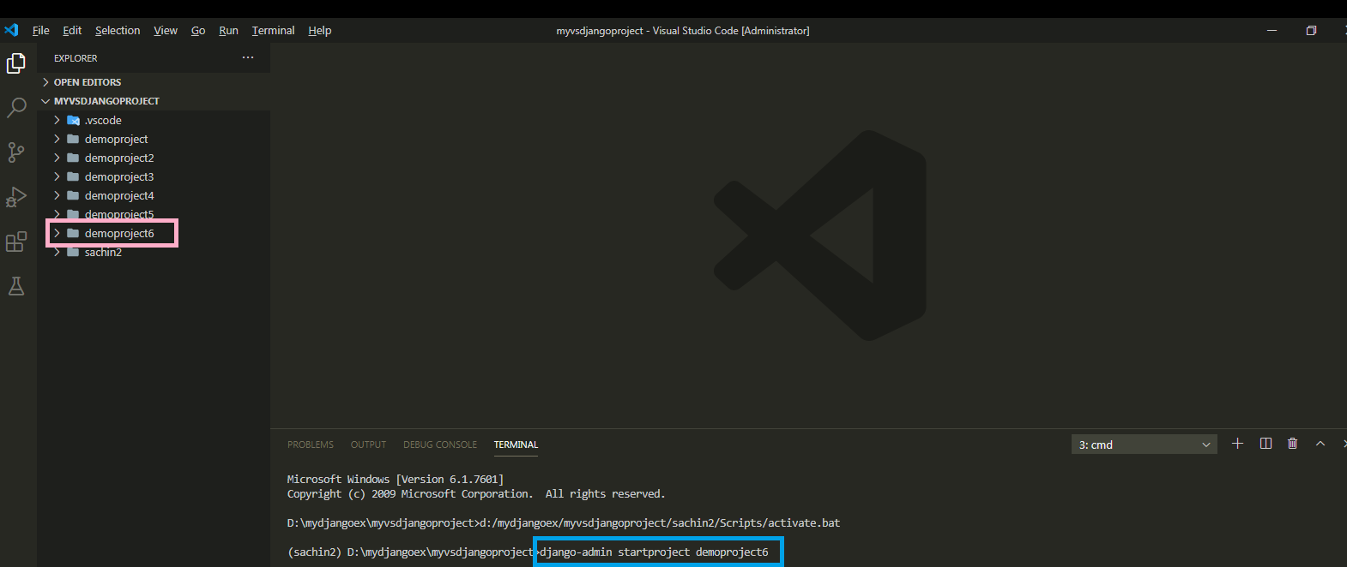
Step 2-Creating Django Project In VS Code

Slide 11
Step 3- Creating The App
As before we must create an app inside our demoproject6 folder by using the following command :
django-admin startapp appname
where appname is the name of our Django app

Slide 12
Step 3- Creating The App
Like previous example , in this project also we will create 2 apps called courses and trainers.
Go to the outer demoproject6 folder and type the following two commands
django-admin startapp courses
django-admin startapp trainers
When we execute the above command Django will create appropriate file/folder structure for our app

Slide 13
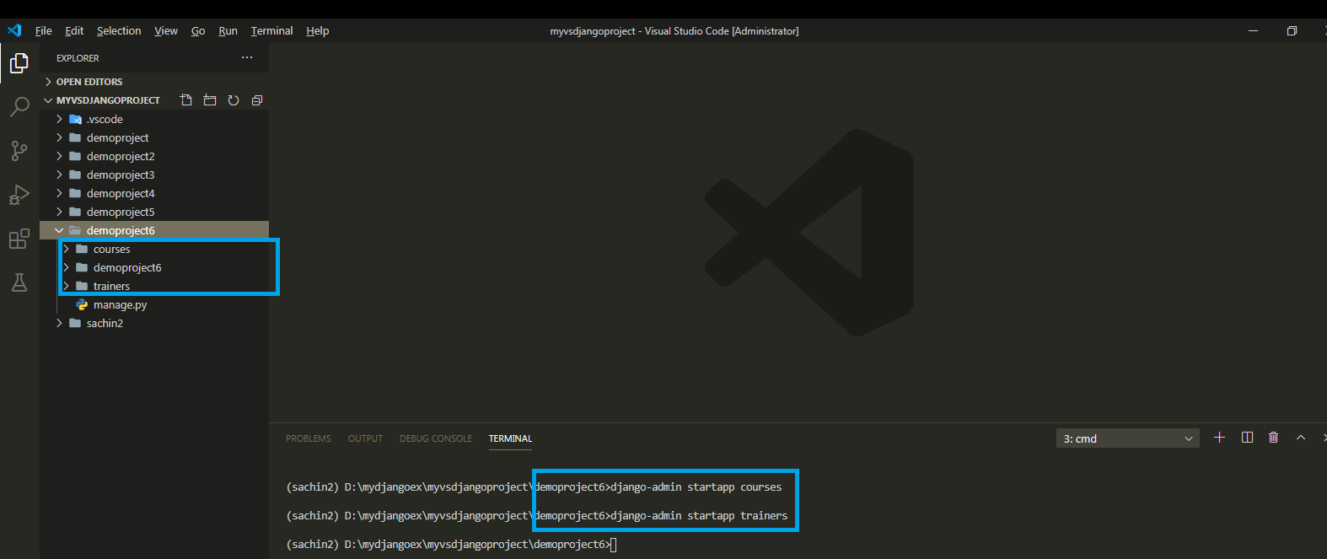
Step 3- Creating The Apps

Slide 14
Step 4: Activating The App
As done before , after creating the app we must let Django know about it by making the entry in the INSTALLED_APPS list of the settings.py file of the default app given by Django.

Slide 15
Step 4: Activating The App
Open the settings.py file in the demoproject6 app of our demoproject6 folder and make the entry shown in green color in the INSTALLED_APPS list
Code:
INSTALLED_APPS = [
'django.contrib.admin',
'django.contrib.auth',
'django.contrib.contenttypes',
'django.contrib.sessions',
'django.contrib.messages',
'django.contrib.staticfiles',
‘courses',
‘trainers’
]

Slide 16
Step 5: Creating The templates Directory
The next step is to create the templates folder
Now since we are using the separate folder approach of using templates , so we must follow the below mentioned steps as discussed before:
Go to the main project folder called demoproject6 and create a folder there called templates
Now inside templates folder , create 2 separate sub folders called courses and trainers

Slide 17
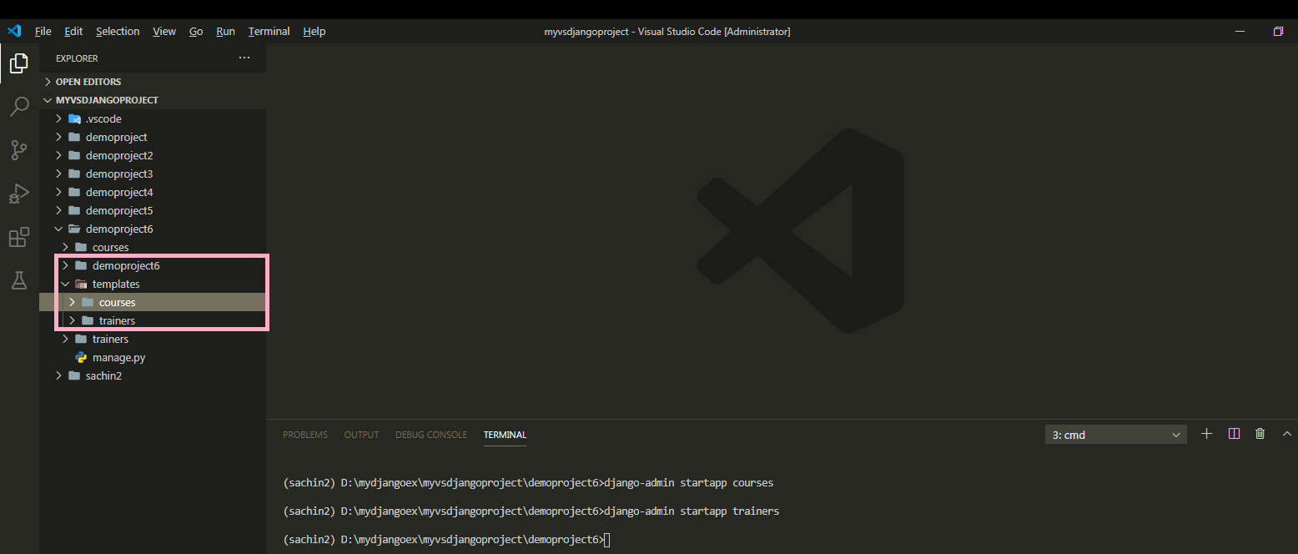
Step 5: Creating The templates Directory

Slide 18
Step 6: Updating The settings.py File
As discussed previously , after creating templates folder we must inform Django about it.
To do this we must follow the following steps:
Open the settings.py file in the demoproject6 app
Write the code shown in green color
TEMPLATES_DIR=os.path.join(BASE_DIR, 'templates')
TEMPLATES = [
{ ...
'DIRS': [TEMPLATES_DIR],
... },
]

Slide 19
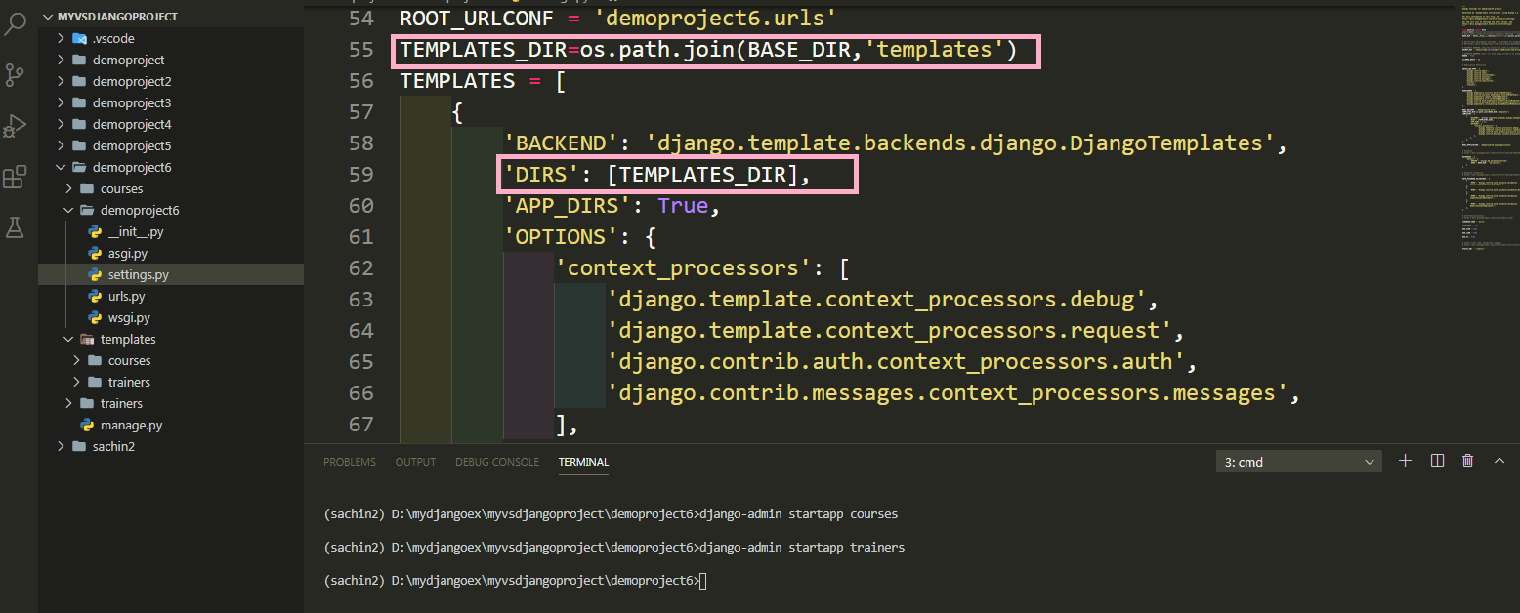
Step 6: Updating The settings.py File

Slide 20
Step 7: Creating The HTML Files
Once we’ve done creating templates folder structure then we can create an html files needed by our apps.
We will start by creating 2 html files each for courses and trainers apps called:
frontendcourses.html
backendcourses.html
frontendtrainers.html
backendtrainers.html
However , unlike the previous app we need to put these html files in their respective subfolders inside the templates folder

Slide 21
Step 7: Creating The HTML File
#frontendcourses.html
<!DOCTYPE html>
<html lang="en">
<head>
<meta charset="UTF-8">
<meta name="viewport" content="width=device-width, initial-scale=1.0">
<title>Front End Courses</title>
</head>
<body>
<h2> Welcome To Sharma Computer Academy</h2>
<h3>Our Front-End Courses</h3>
<ul>
<li>HTML 5</li>
<li>CSS 3</li>
<li>Modern Java Script</li>
<li>BootStrap</li>
<li>JQuery</li>
<li>Ajax</li>
</ul>
</body>
</html>

Slide 22
Step 7: Creating The HTML File
#backendcourses.html
<!DOCTYPE html>
<html lang="en">
<head>
<meta charset="UTF-8">
<meta name="viewport" content="width=device-width, initial-scale=1.0">
<title>Back End Courses</title>
</head>
<body>
<h2> Welcome To Sharma Computer Academy</h2>
<h3>Our Back-End Courses</h3>
<ul>
<li>Django</li>
<li>JEE</li>
<li>Spring Core</li>
<li>Spring Boot</li>
<li>ASP.Net</li>
<li>Node JS</li>
</ul>
</body>
</html>

Slide 23
Step 7: Creating The HTML File
#frontendtrainers.html
<!DOCTYPE html>
<html lang="en">
<head>
<meta charset="UTF-8">
<meta name="viewport" content="width=device-width, initial-scale=1.0">
<title>Front End Trainers</title>
</head>
<body>
<h2> Welcome To Sharma Computer Academy</h2>
<h3>Our Front-End Trainers</h3>
<ul>
<li>Mr. Paramjeet Singh</li>
<li>Ms. Seema Sharma</li>
<li>Mr. Sanjeev Sharma</li>
<li>Mr. Sachin Kapoor</li>
</ul>
</body>
</html>

Slide 24
Step 7: Creating The HTML File
#backendtrainers.html
<!DOCTYPE html>
<html lang="en">
<head>
<meta charset="UTF-8">
<meta name="viewport" content="width=device-width, initial-scale=1.0">
<title>Back End Trainers</title>
</head>
<body>
<h2> Welcome To Sharma Computer Academy</h2>
<h3>Our Back-End Trainers</h3>
<ul>
<li>Mr. Naman Garg</li>
<li>Mr. Aftaab</li>
<li>Mr. Arif</li>
<li>Mr. Sachin Kapoor</li>
</ul>
</body>
</html>

Slide 25
Step 8:Creating The View
Now we have the template in place, so we need to update our views.py.
Like previous project , since we are using templates we have to call the function render() from our views to render the template.
But this time while passing second argument to render() we must include the folder name also in the path to the html file.

Slide 26
Step 8:Creating The View
Following is the code for views.py, of our courses app where we are simply passing the original request object and the name of our site template.
courses/views.py
from django.shortcuts import render
def showFrontEndCourses(request):
return render(request,‘courses/frontendcourses.html')
def showBackEndCourses(request):
return render(request,‘courses/backendcourses.html')

Slide 27
Step 8:Creating The View
Similarly following is the code for views.py, of our trainers app
trainers/views.py
from django.shortcuts import render
def showFrontEndTrainers(request):
return render(request,‘trainers/frontendtrainers.html')
def showBackEndTrainers(request):
return render(request,‘trainers/backendtrainers.html')

Slide 28
Step 9:Configuring The View In Url
After creating and updating the views.py as shown in the previous slide we need to tell Django this is the view we want displayed when someone navigates to a particular url
As usual we do this by configuring our URLs at 2 places:
Inside the courses and trainers app’s urls.py file
Inside the site’s main urls.py

Slide 29
Step 9:Configuring The View In Url
In the VS Code create a new file called urls.py in both , courses and trainers apps folder , and write the following code in it.
Code (courses/urls.py):
from django.urls import path
from . import views
urlpatterns = [
path('showfe/', views.showFrontEndCourses),
path('showbe/', views.showBackEndCourses),
]

Slide 30
Step 9:Configuring The View In Url
Code (trainers/urls.py):
from django.urls import path
from . import views
urlpatterns = [
path('showfe/', views.showFrontEndTrainers),
path('showbe/', views.showBackEndTrianers),
]

Slide 31
Step 9:Configuring The Sites Main urls.py File
As we know whenever a request arrives it first hits the main urls.py file , that is , the file urls.py in the directory demoproject6.
So we must configure this file also so that it simply redirects the request to our courses and trainer app’s urls.py file whenever a matching request arrives

Slide 32
Step 9:Configuring The Sites Main urls.py File
In the VS Code open the file called urls.py in the demoproject6 folder and update the code in it as shown below in green.
Code (demoproject6/urls.py):
from django.contrib import admin
from django.urls import path,include
urlpatterns = [
path('admin/', admin.site.urls),
path('courses/',include('courses.urls')),
path('trainers/',include('trainers.urls')),
]

Slide 33
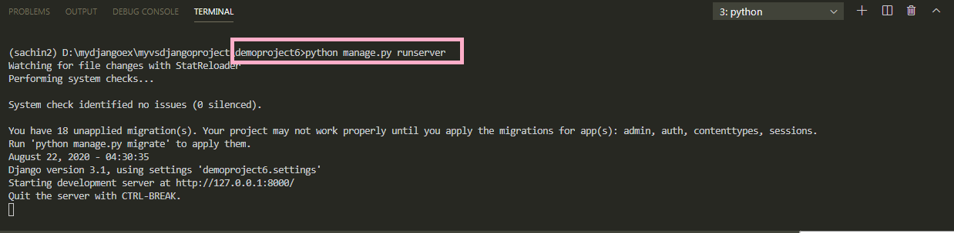
Step 10:Running The Server
To run the app, go to the project folder demoproject5 by using cd command and type the runserver command in VS Code terminal
cd demoproject6
python manage.py runserver.
The server runs on the default port 8000, and we’ll see output like the following output in the terminal window:

Slide 34
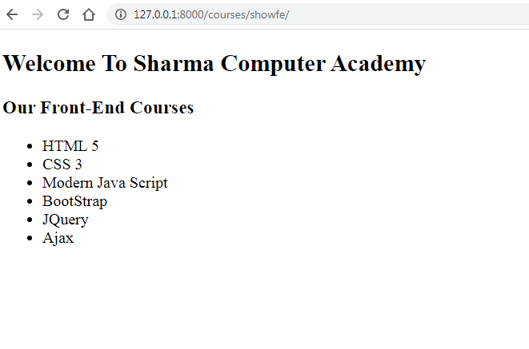
Step 11: Opening The Page
Ctrl+click the http://127.0.0.1:8000/ URL in the terminal output window to
open default browser and type the url http://127.0.0.1:8000/courses/showfe

Slide 35
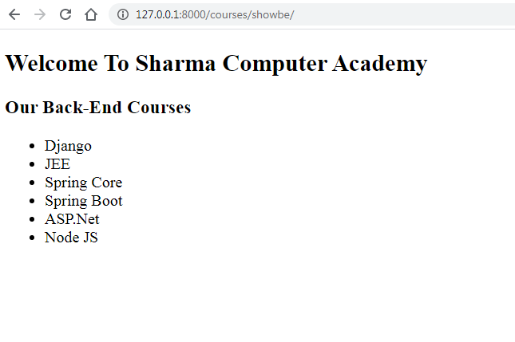
Step 11: Opening The Page
Type the url http://127.0.0.1:8000/courses/showbe

Slide 36
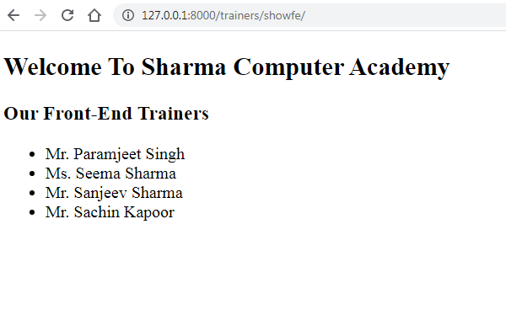
Step 11: Opening The Page
Type the url http://127.0.0.1:8000/trainers/showfe

Slide 37
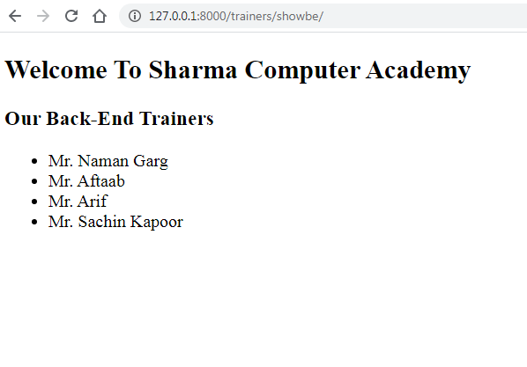
Step 11: Opening The Page
Type the url http://127.0.0.1:8000/trainers/showbe

